Slide 1
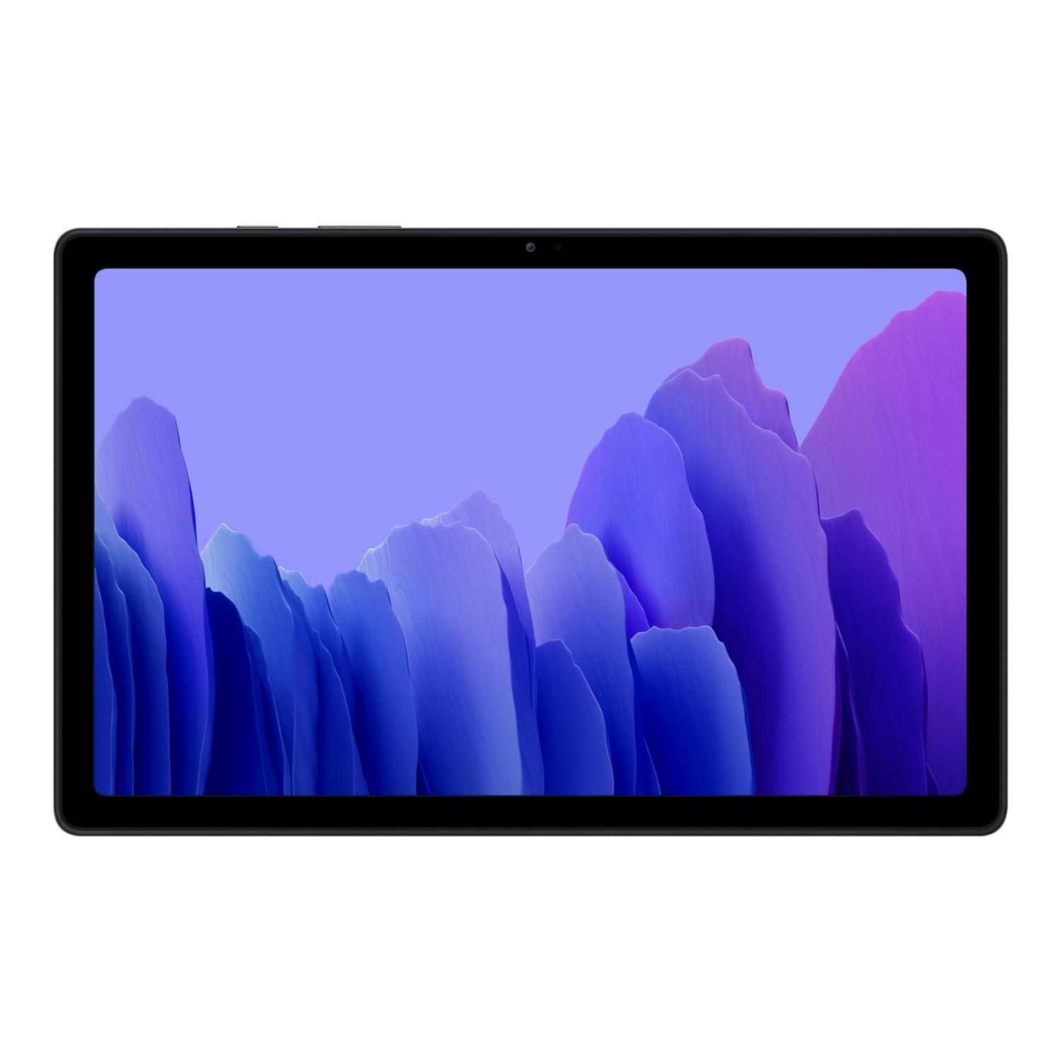

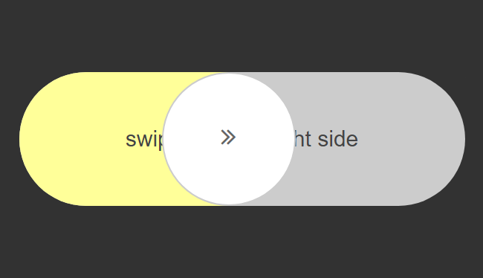

Slide 2
CMP6187 – Mobile Game Development – Week 1

Slide 3


This tutorial:
Set up Unity
Set up mobile Visualization
“Build” first simple game

Slide 4
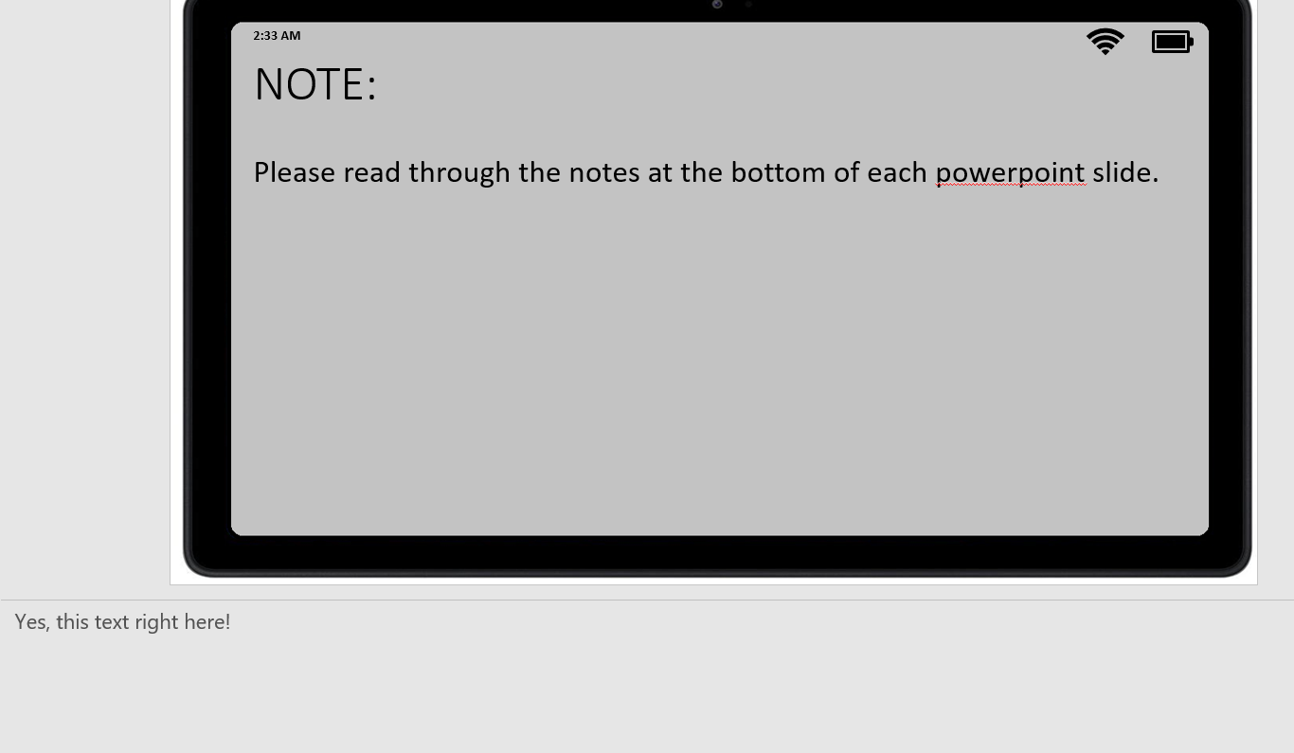
NOTE:
Please read through the notes at the bottom of each power point slide.
Notes:
Yes, this text right here!

Slide 5
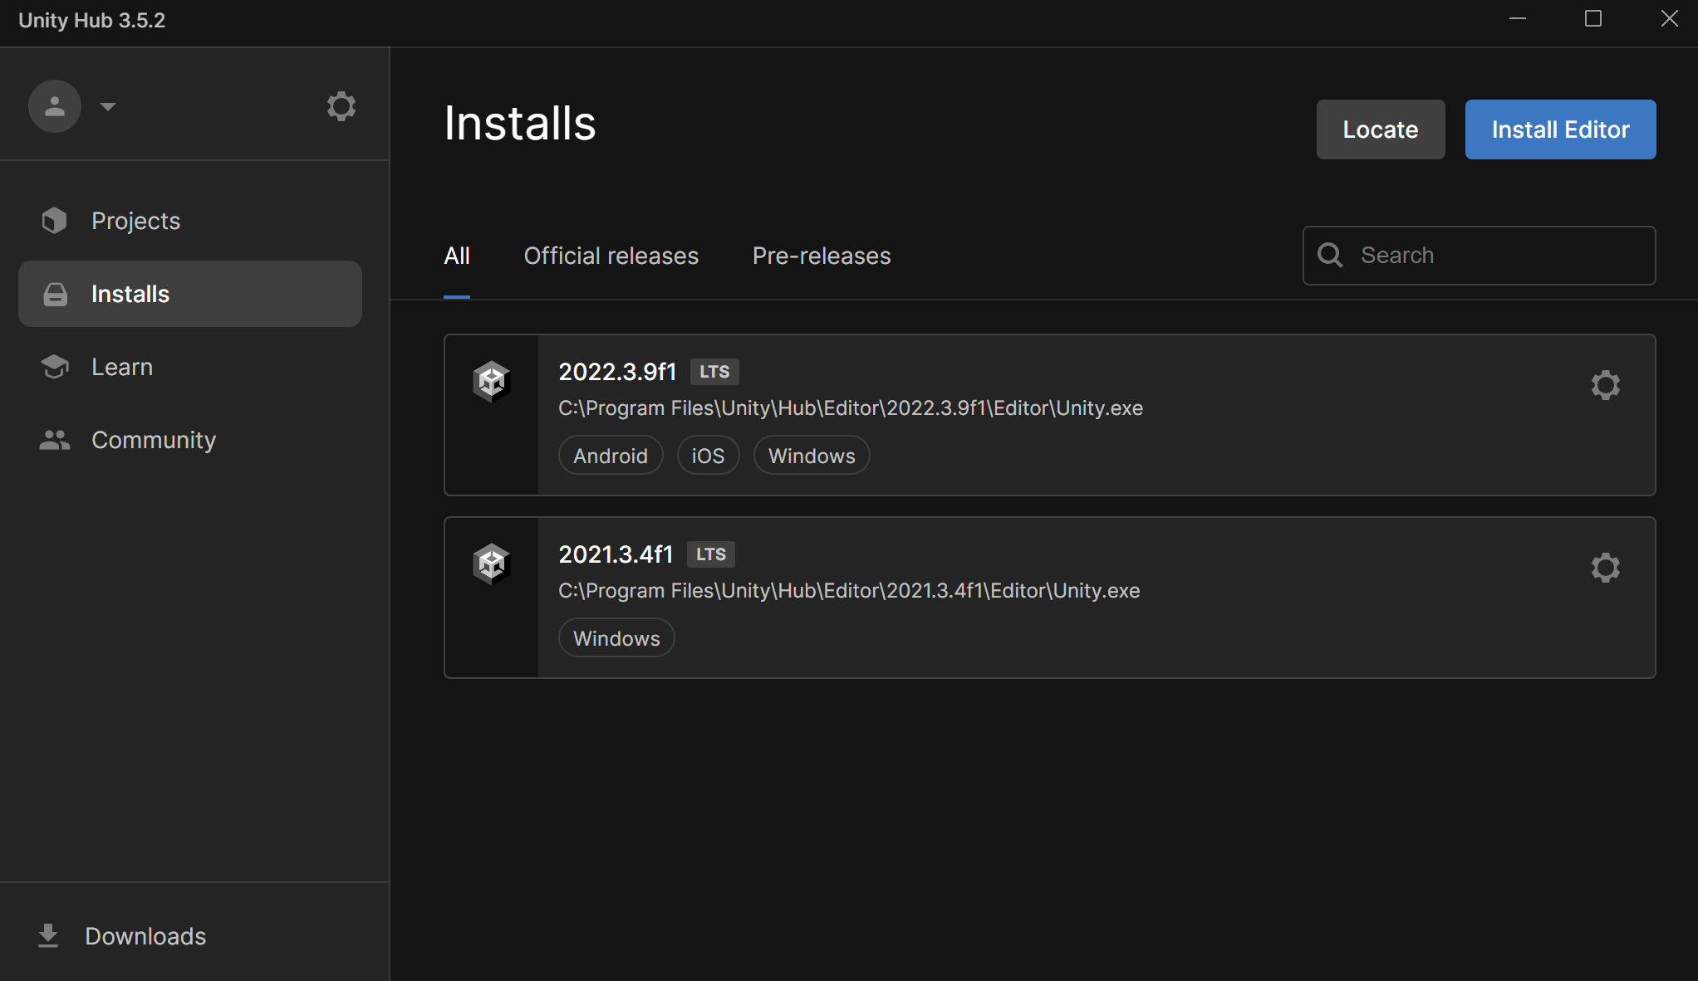
Setting-up Unity
Notes:
This will look different depending on your version of Unity/Unity Hub.
When you first install a version of Unity don’t forget to include the Android and iOS platforms!
You can add these modules via the settings cog on the right or triple dot.
(May not be needed on university machines, but important for home)

Slide 6
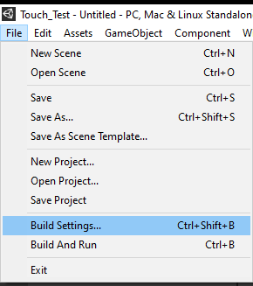
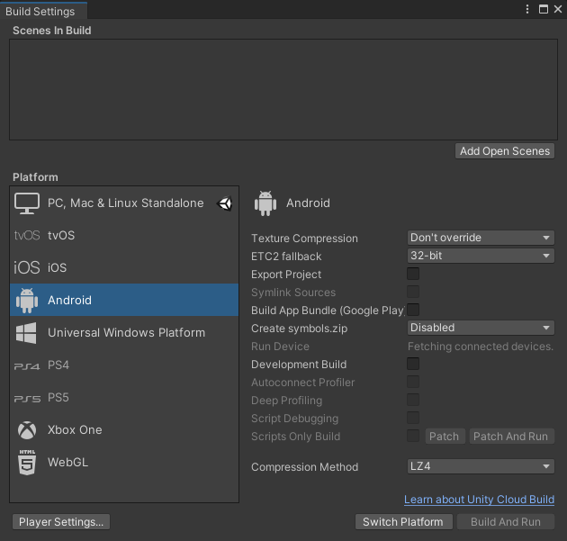
Setting-up Unity
Notes:
If we’ve already installed Android and iOS as part of our platform, we can switch to them by going to File > Build Settings > Switch Platform after selecting which we want.
If Android/iOS are greyed out here this is where we can install them, or return to the Unity Hub/installer and make sure to include them as part of the project.

Slide 7
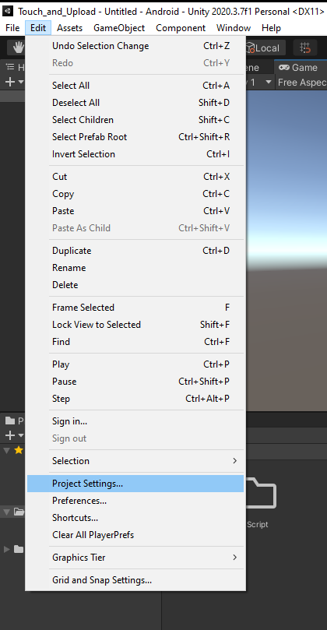
Setting-up Unity
Notes:
We need to ensure the project is setup as the desired device. Edit > Project Settings > Editor

Slide 8
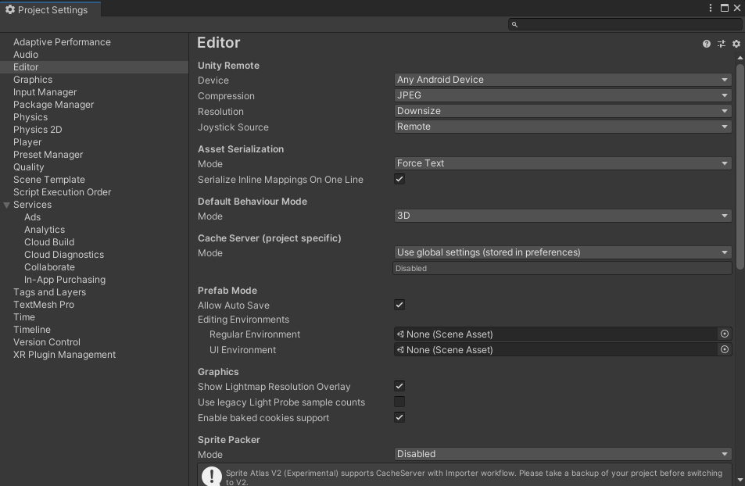
Setting-up Unity
Notes:
Here we can set the Android/iOS device, or, if we’re remotely accessing our phone, it will be displayed here as well. (See Unity Remote 5 Slide)

Slide 9
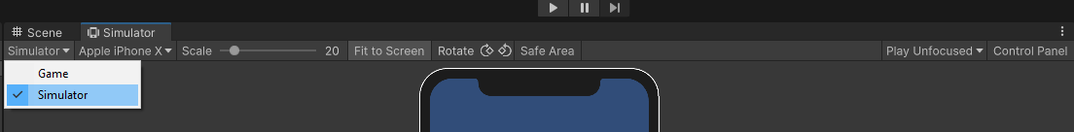
NOTE:
Newer versions of Unity include the Device Simulator built into the editor already, but if you have an older version you can install the preview package following the next 2 power point sides.

Slide 10
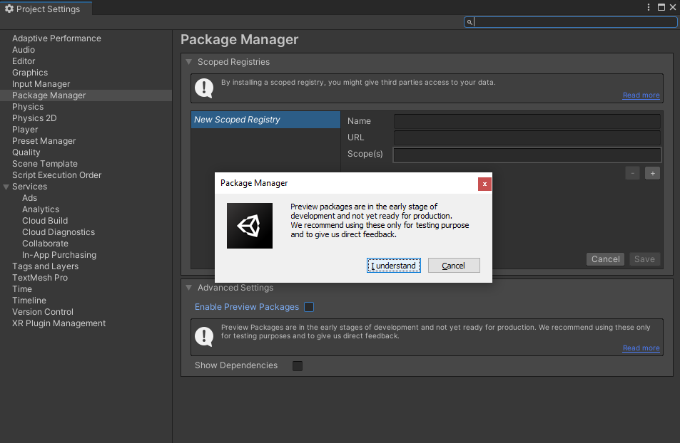
Setting-up Unity
Notes:
Only needed when working on older Unity versions (2019 and earlier 2021 builds I believe).

Slide 11
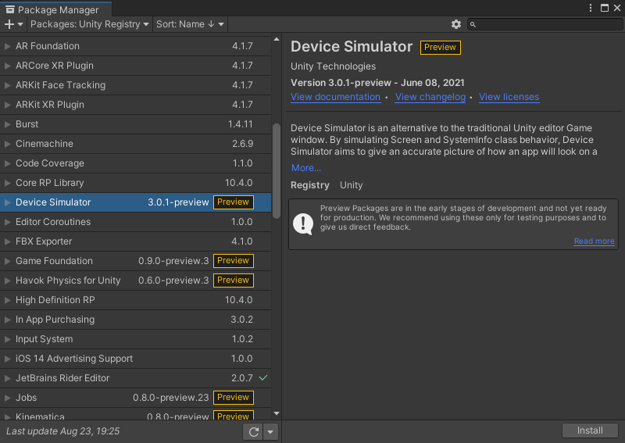
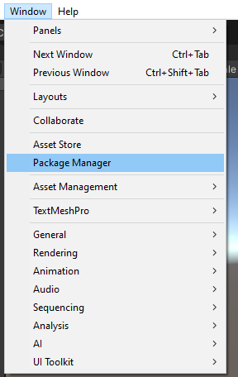
Setting-up Unity
Notes:
Only needed when working on older Unity versions (2019 and earlier 2021 builds I believe).

Slide 12
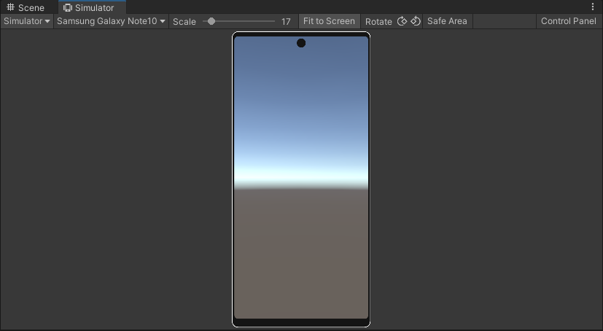
Setting-up Unity

Slide 13
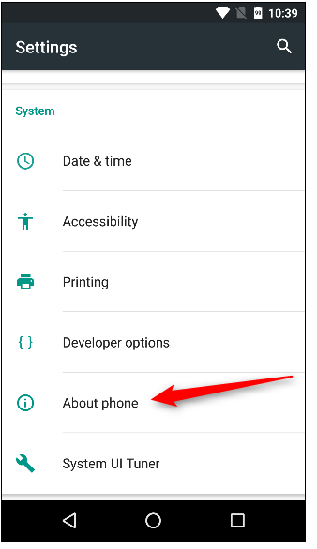
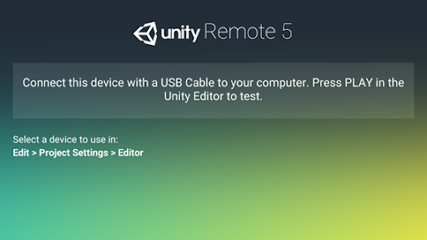
Setting-up Unity
Notes:
Here we can connect our phone to Unity directly via USB. For iOS phones this may not work unless iTunes is installed on your PC.

Slide 14
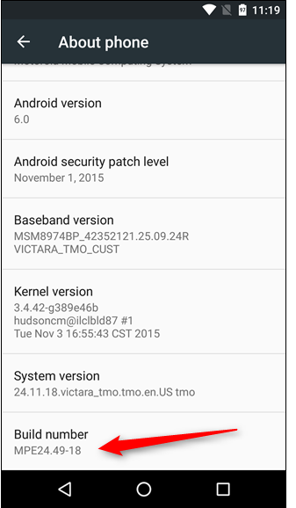
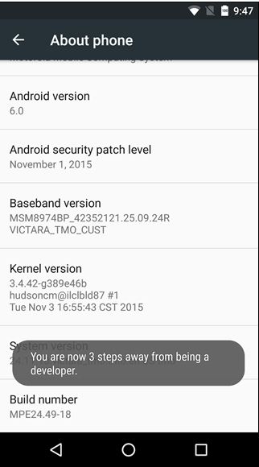
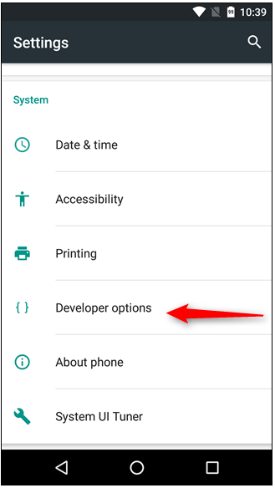
Setting-up Unity
Notes:
Android phones must enable developer options before the USB is recognized.

Slide 15
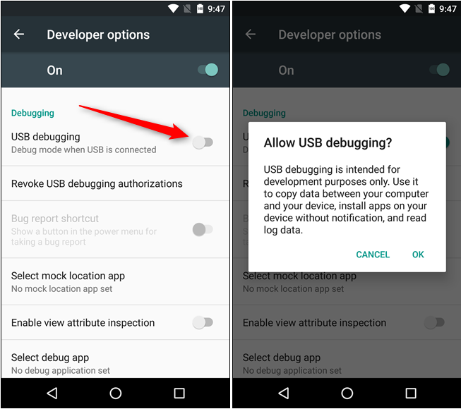
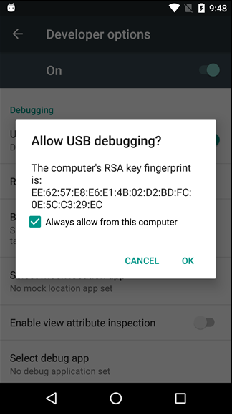
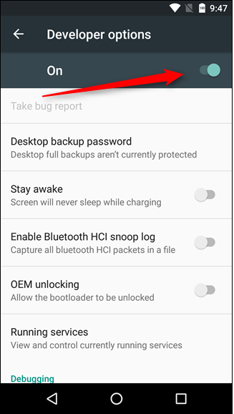
Setting-up Unity
Notes:
Android phones must enable developer options before the USB is recognized.

Slide 16

Publishing Settings
To publish an app on the Google Play store, your app must be “signed”
Notes:
These are old slides I’ve left in for reference as we will need to publish later, but don’t worry about it in Week 1.

Slide 17

Signing and Keys
A Keystore is an encrypted storage container file for "keys" and certificates (similar to an encrypted ZIP or RAR file).
A key / certificate on the other hand is an RSA public / private key pair. It is used to sign your apps. The signature identifies you as the developer. Never ever loose the key you used to publish your app to the play store. That key is unique can not be recreated. If you loose the keystore file or forget the keystore / key password, you can't update your app anymore. You basically lost the only thing that authenticates you as the developer.
Also keep the keystore and the passwords save and secure. If someone gets his hands on your key (the file as well as the passwords) he can actually create new builds, update your app and may even tinker with inapp purchases or anything that requires your personal certificate.
You can't publish an unsigned APK (or one signed with a development certificate). The Playstore only accept APKs that are signed with a personal key.
~ Bunny83 (Unity Forum)
This is how I imagine Bunny83 to look

Slide 18
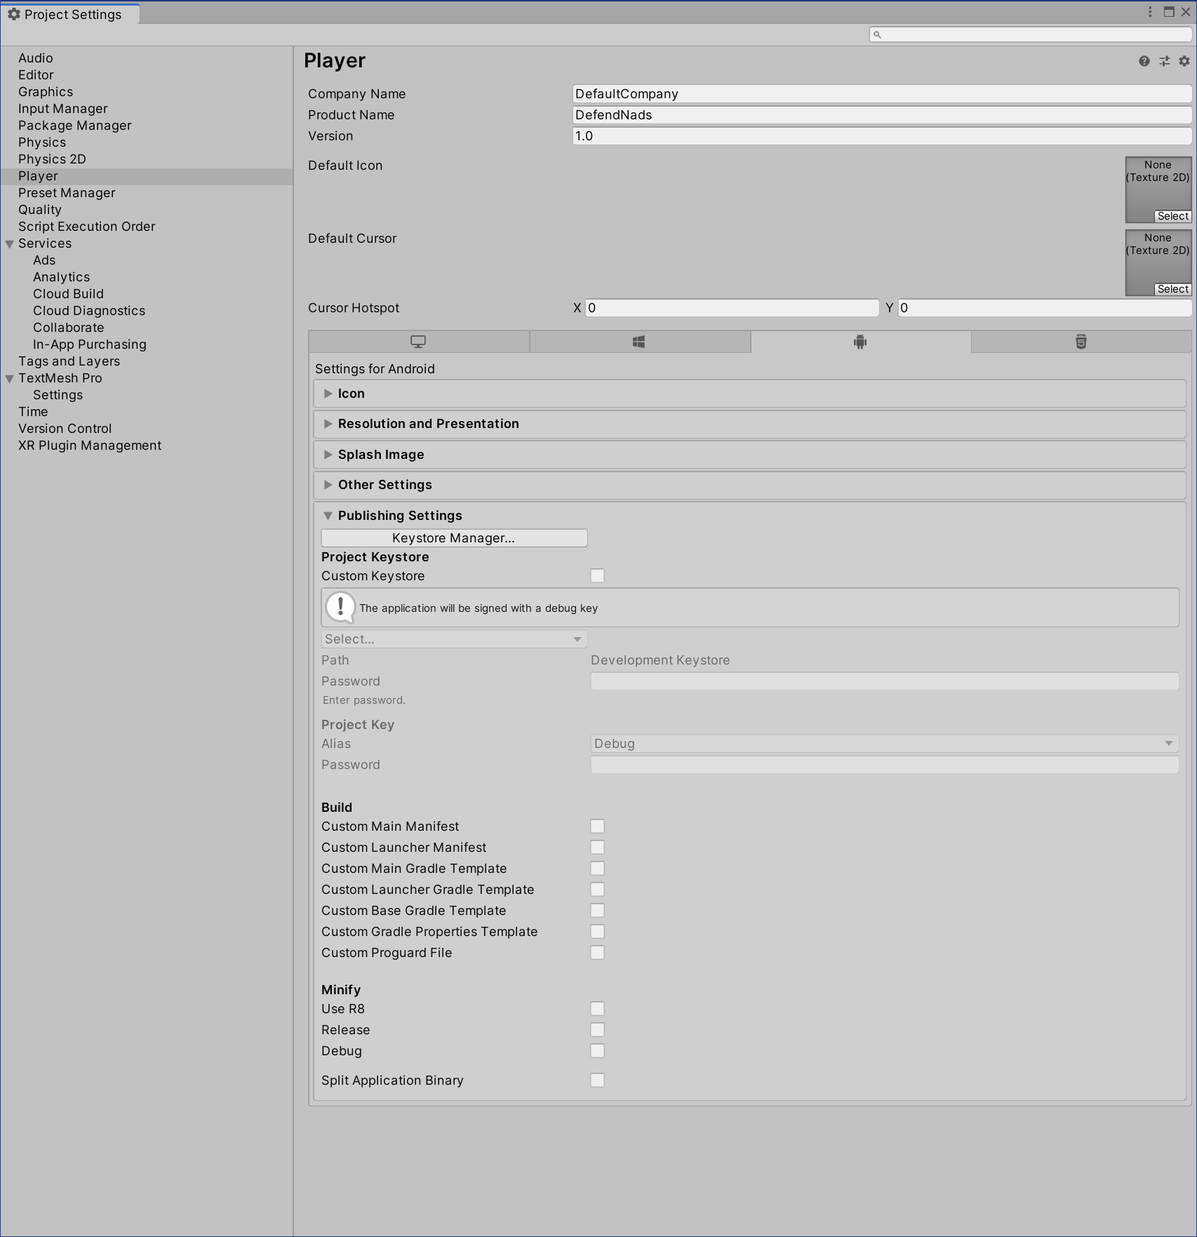
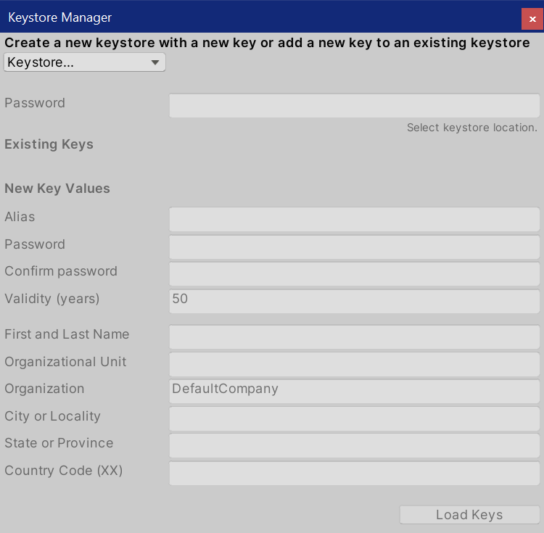
Luckily It’s Fairly Straight Forward
TOP TIPS
Don’t lose your key
Give your self a company name
Package name will look something like this
com.COMPANYNAME.PROJECTNAME
From here you can create a Key File, and save it to any location on your pc choose.
Don’t lose the key, you will need to publish.

Slide 19
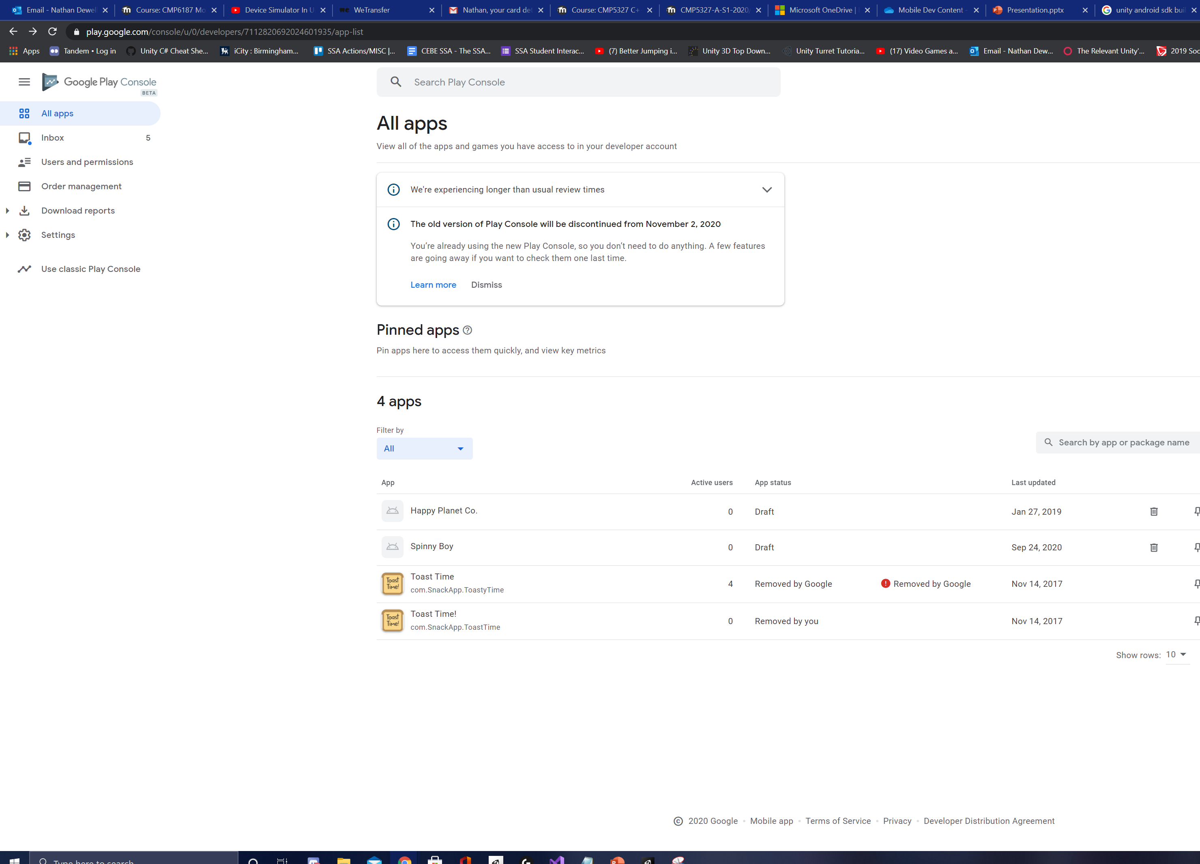
The Play Store Dev Dashboard

Slide 20
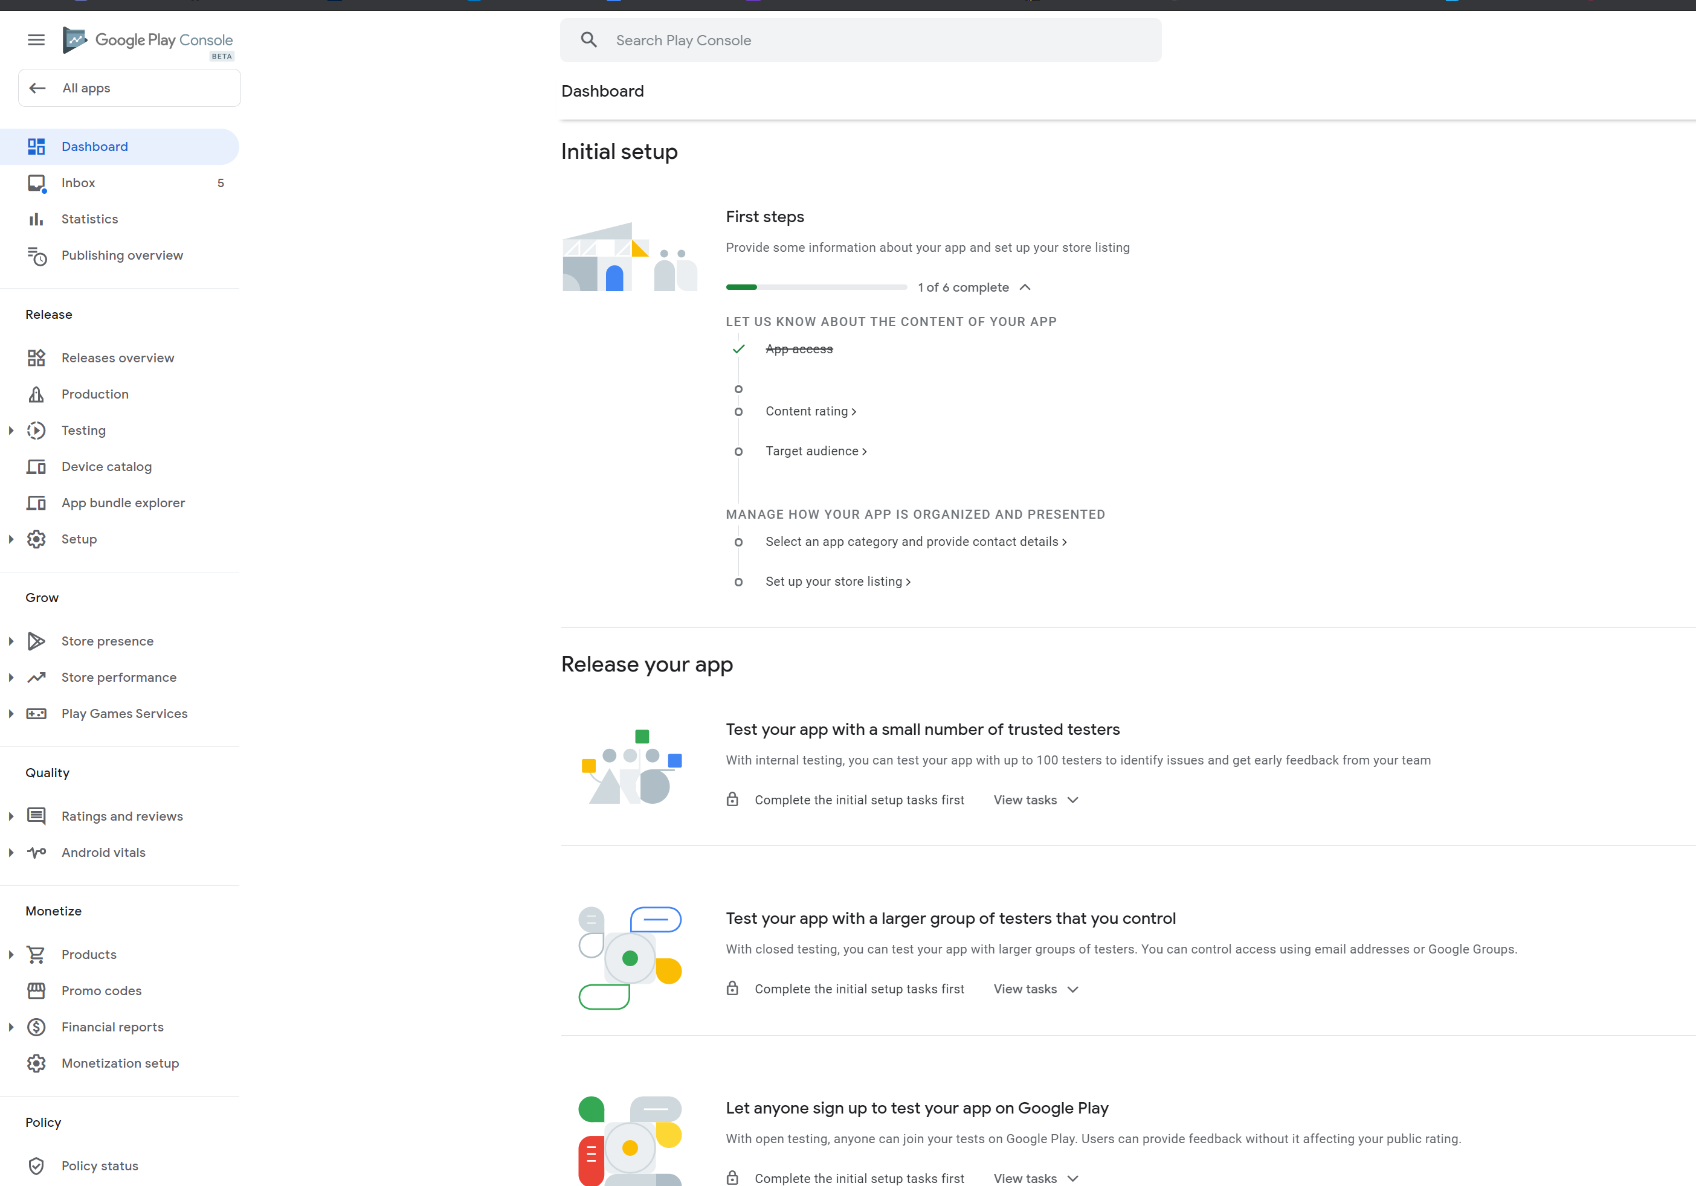

Slide 21
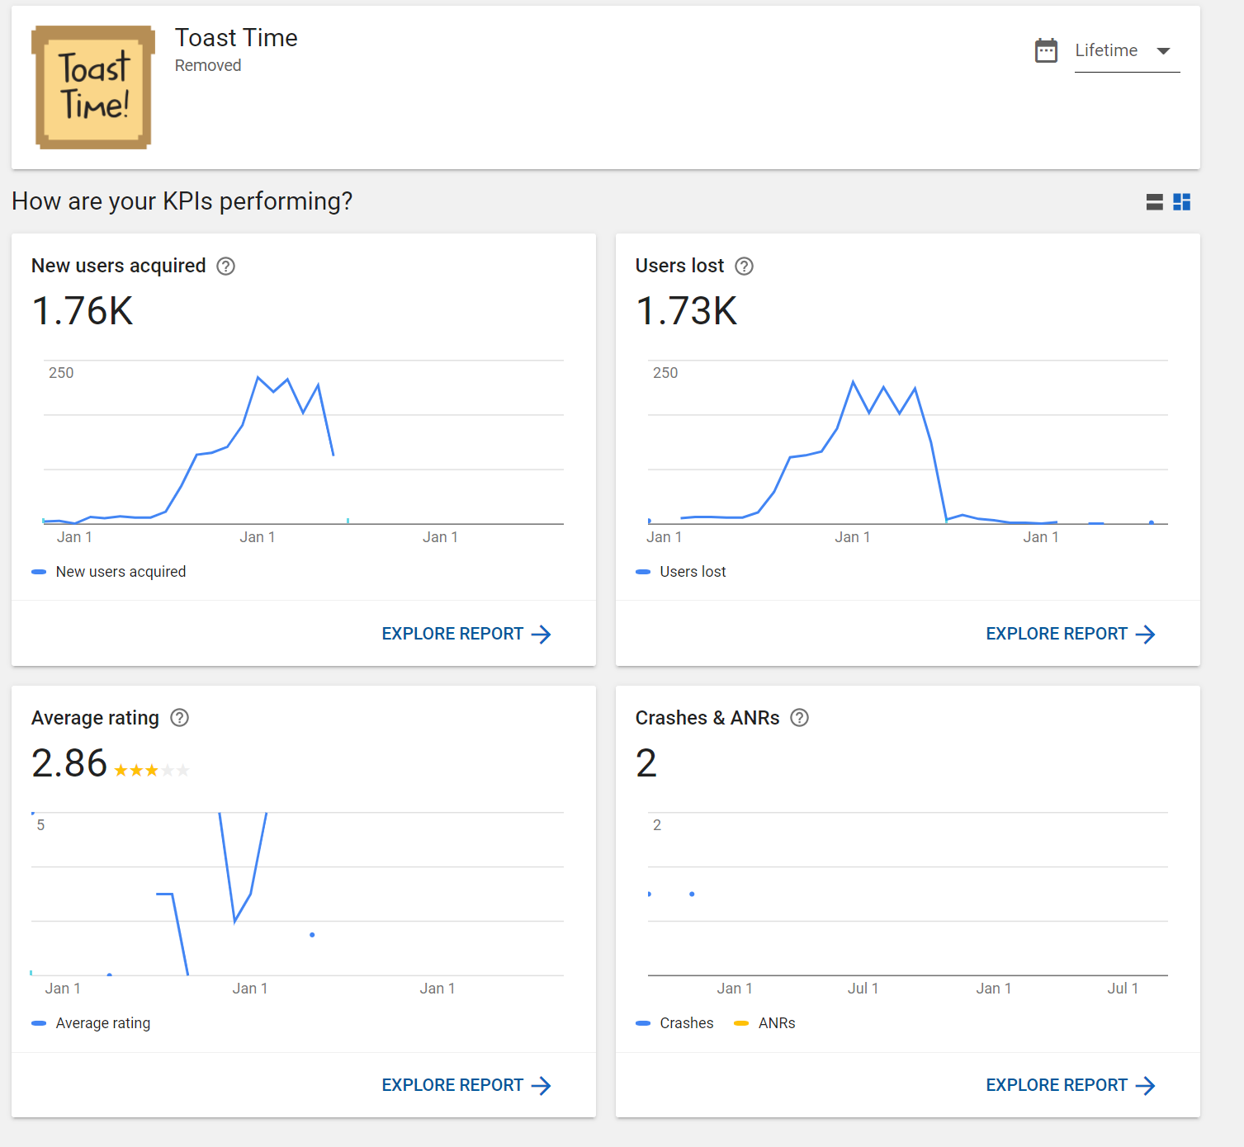
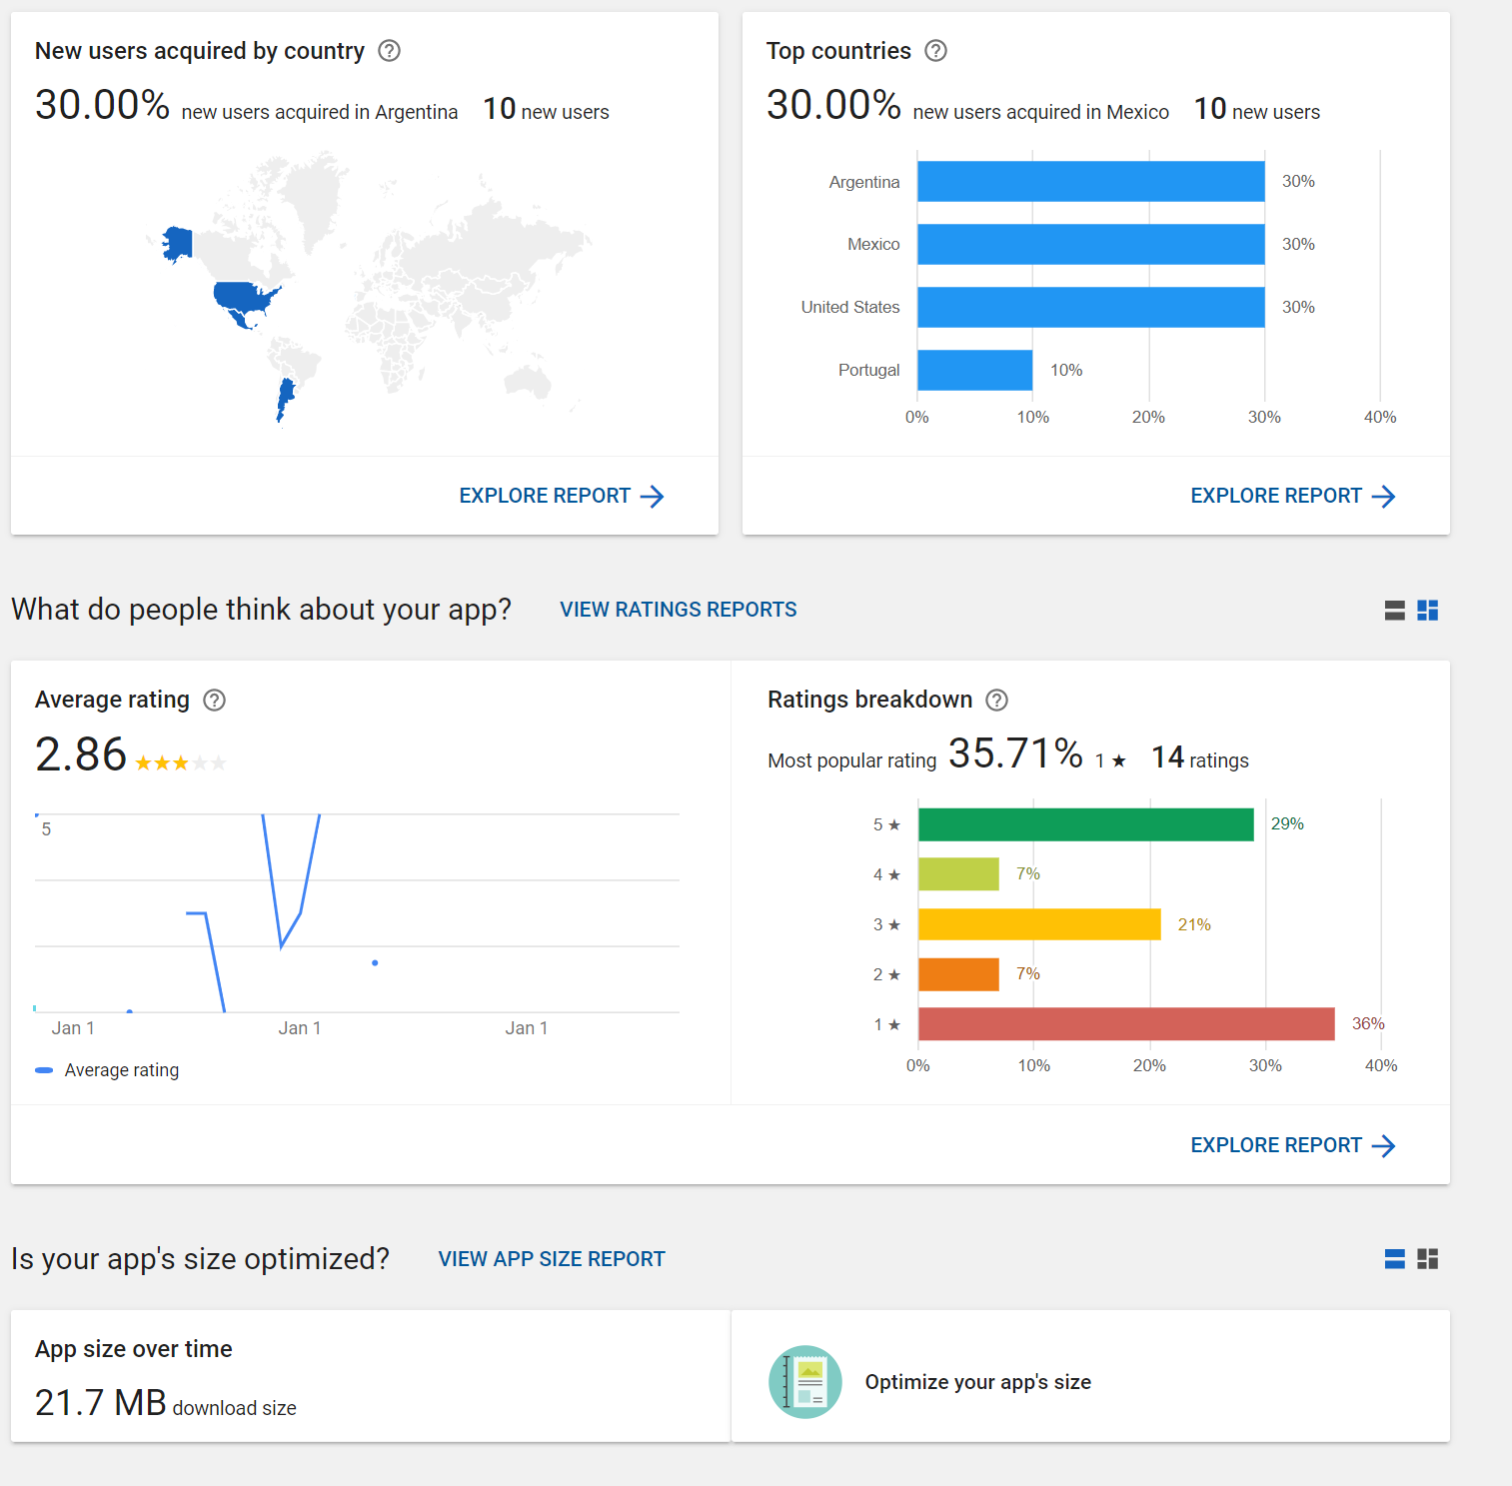

Slide 22





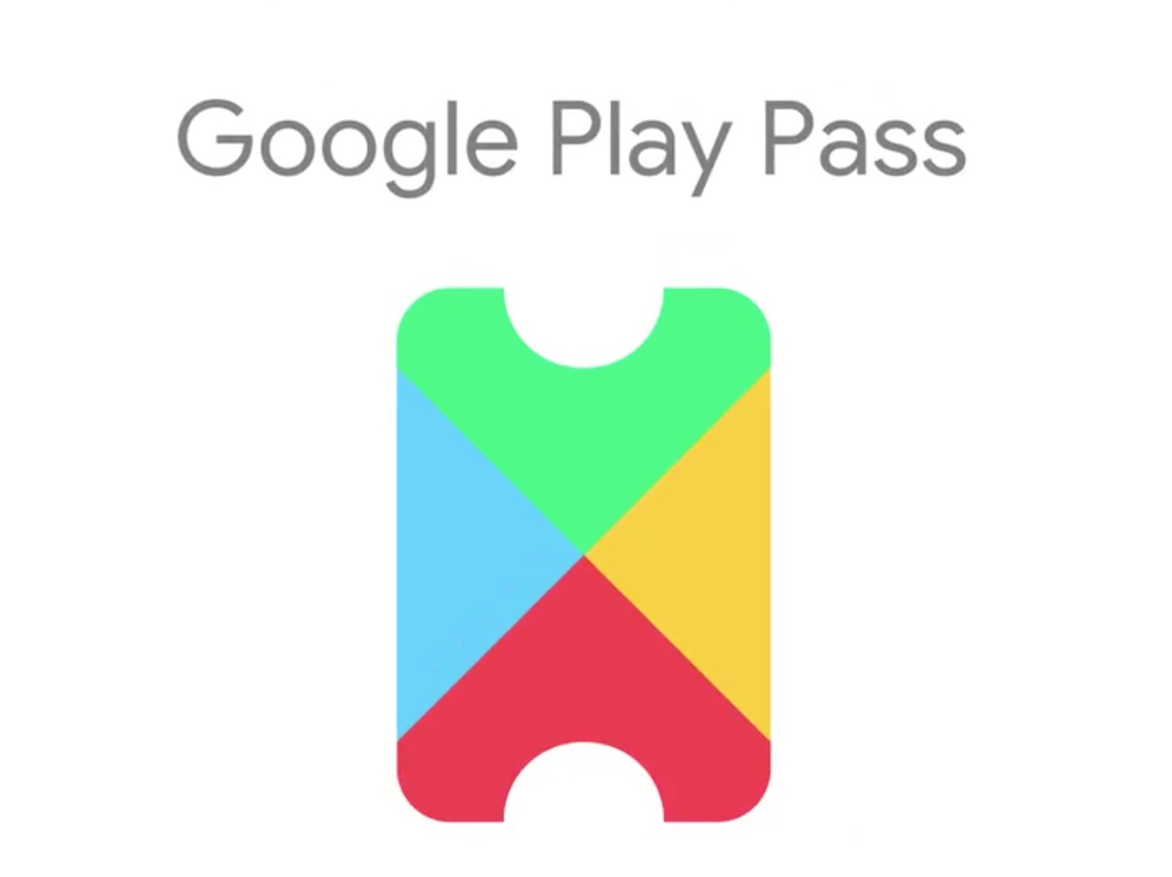



Slide 23
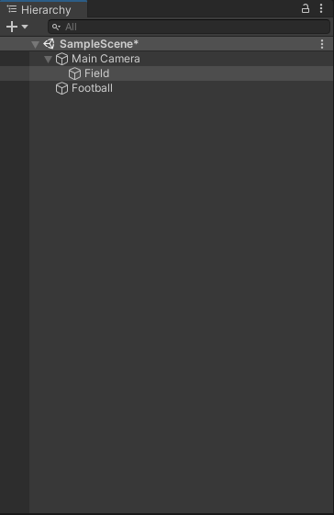
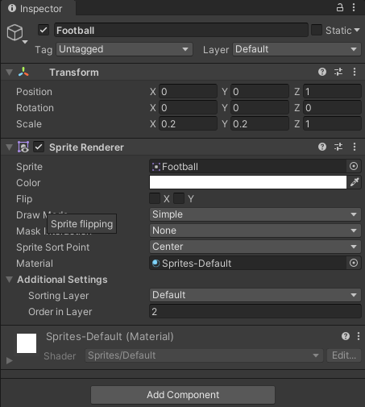
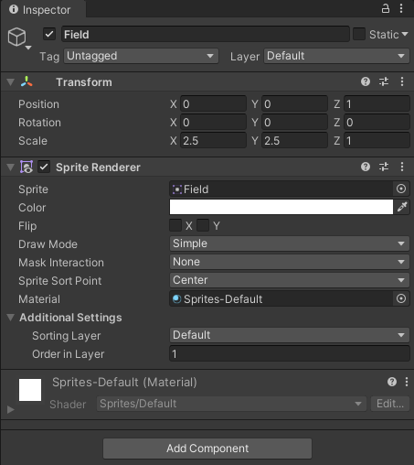
Notes:
NOTE: Old slides on setting up a simple game, you should be familiar with creating a 2D game but you can use this for practice.
May have deprecated code, haven’t tested!
There are additionally YouTube videos on the final slide which is what these slides are based on.
First let’s get assets

Slide 24
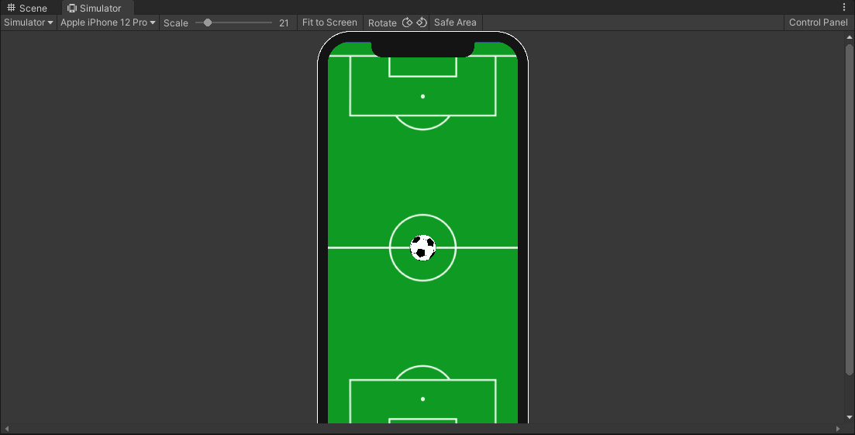
Notes:
Should look something like this

Slide 25
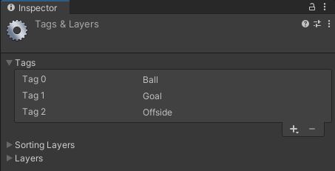
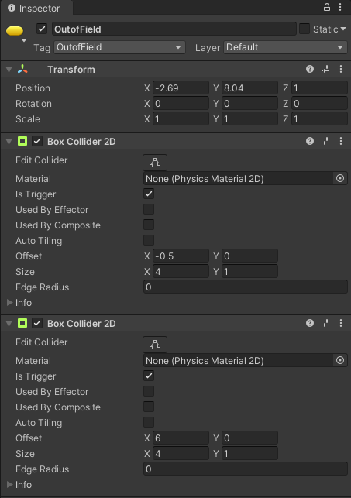
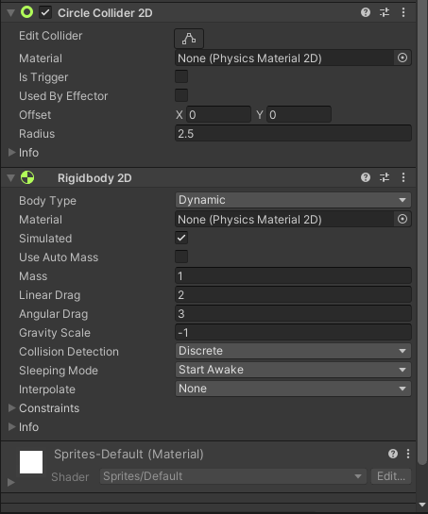
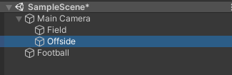
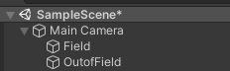
Notes:
Let’s create some tags to add to our objects make sure our ball goes up and has a collider. Let’s create an Empty object called offside and give it two colliders

Slide 26
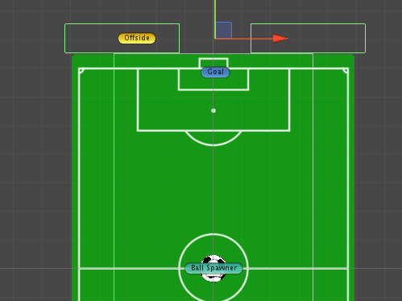
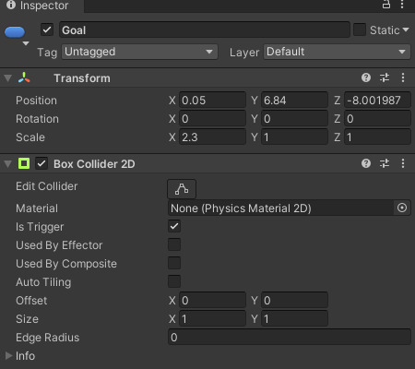
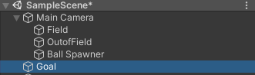
Notes:
Let’s create the ball spawner and our goalpost which we will adjust

Slide 27
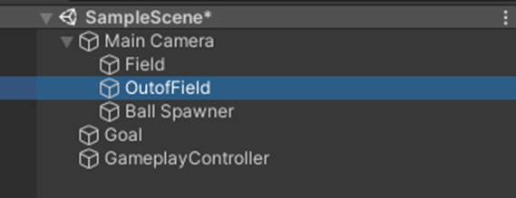
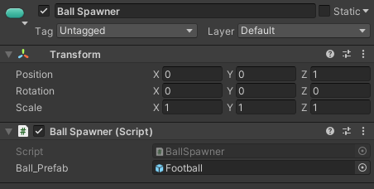
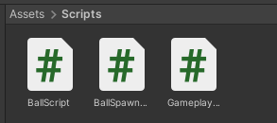
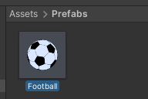
public class BallSpawner : MonoBehaviour
{
public GameObject ball_Prefab;
public void SpawnBall()
{
GameObject ball_Obj = Instantiate(ball_Prefab);
ball_Obj.transform.position = transform.position;
}
}
Notes:
We then create 3 scripts. And attach to the respective objects. Let’s make our ball a prefab and we can delete it.
Now in the ball spawner we instantiate the balls where we left our empty object

Slide 28
public class BallScript : MonoBehaviour
{
private float min_X = -2.9f, max_X = 2.9f;
public float move_Speed = 2f;
private Rigidbody2D ballBody;
void Awake()
{
ballBody = GetComponent<Rigidbody2D>();
ballBody.gravityScale = 0f;
}
void Start()
{
if (Random.Range(0, 2) > 0)
{
move_Speed *= -1f;
}
}
// Update is called once per frame
void Update()
{
MoveBall();
}
void MoveBall()
{
Vector3 temp = transform.position;
temp.x += move_Speed * Time.deltaTime;
if(temp.x > max_X | temp.x < min_X)
{
move_Speed *= -1f;
}
transform.position = temp;
}
Notes:
The ball should be shooting straight away. We want it to move side by side first… Let’s make this happen with the moveball and we deactivate the gravity.

Slide 29
public class GameplayController : MonoBehaviour
{
public static GameplayController instance;
public BallSpawner ballSpawner;
[HideInInspector]
public BallScript currentBall;
private int score;
void Awake()
{
if (instance == null)
instance = this;
}
void Start()
{
ballSpawner.SpawnBall();
}
Notes:
Now for our game controller, Let’s make it a singleton.
We are going to spawn the balls from here now and we will need to keep track of the score.

Slide 30
public class BallScript : MonoBehaviour
{
private float min_X = -2.9f, max_X = 2.9f;
private bool canMove;
public float move_Speed = 2f;
private Rigidbody2D ballBody;
void Awake()
{
ballBody = GetComponent<Rigidbody2D>();
ballBody.gravityScale = 0f;
}
void Start()
{
canMove = true;
if (Random.Range(0, 2) > 0)
{
move_Speed *= -1f;
}
GameplayController.instance.currentBall = this;
}
// Update is called once per frame
void Update()
{
MoveBall();
}
void MoveBall()
{
if (canMove)
{
Vector3 temp = transform.position;
temp.x += move_Speed * Time.deltaTime;
if(temp.x > max_X | temp.x < min_X)
{
move_Speed *= -1f;
}
transform.position = temp;
}
}
public void Kick()
{
canMove = false;
ballBody.gravityScale = Random.Range(-4, -2);
}
Notes:
Going back to the ball script let’s define when it is kicked and define the current ball is used in the gameManager.

Slide 31
public class GameplayController : MonoBehaviour
{
public static GameplayController instance;
public BallSpawner ballSpawner;
[HideInInspector]
public BallScript currentBall;
private int score;
void Awake()
{
if (instance == null)
instance = this;
}
void Start()
{
ballSpawner.SpawnBall();
}
void Update()
{
DetectInput();
}
void DetectInput()
{
if (Input.GetMouseButtonDown(0))
{
currentBall.Kick();
}
}
Notes:
Now we make sure we get the input and kick the ball.

Slide 32
public class BallScript : MonoBehaviour
{
private float min_X = -2.9f, max_X = 2.9f;
private bool canMove;
public float move_Speed = 2f;
private Rigidbody2D ballBody;
void Awake()
{
ballBody = GetComponent<Rigidbody2D>();
ballBody.gravityScale = 0f;
}
void Start()
{
canMove = true;
if (Random.Range(0, 2) > 0)
{
move_Speed *= -1f;
}
GameplayController.instance.currentBall = this;
}
// Update is called once per frame
void Update()
{
MoveBall();
}
void MoveBall()
{
if (canMove)
{
Vector3 temp = transform.position;
temp.x += move_Speed * Time.deltaTime;
if(temp.x > max_X | temp.x < min_X)
{
move_Speed *= -1f;
}
transform.position = temp;
}
}
public void Kick()
{
canMove = false;
ballBody.gravityScale = Random.Range(-4, -2);
}
public void SpawnNewBall()
{
Invoke("NewBall", 2f);
}
void NewBall()
{
ballSpawner.SpawnBall();
}
Notes:
Going back to the ball script let’s define when it is kicked and define the current ball is used in the gameManager.

Slide 33
public class GameplayController : MonoBehaviour
{
public static GameplayController instance;
public BallSpawner ballSpawner;
[HideInInspector]
public BallScript currentBall;
private int score;
void Awake()
{
if (instance == null)
instance = this;
}
void Start()
{
ballSpawner.SpawnBall();
}
void Goal()
{
GameplayController.instance.SpawnNewBall();
}
void RestartGame()
{
GameplayController.instance.RestartGame();
}
void OnTriggerEnter2D(Collider2D target)
{
if(target.gameObject.tag == "Goal")
{
Goal();
Destroy(gameObject,2f);
}
else
{
RestartGame();
}
}
void Update()
{
DetectInput();
}
void DetectInput()
{
if (Input.GetMouseButtonDown(0))
{
currentBall.Kick();
}
}
Notes:
As the ball is kicked we check if it hits the goal and we call a new ball after it scores, otherwise we restart the game.

Slide 34
void MoveBall()
{
if (canMove)
{
Vector3 temp = transform.position;
temp.x += move_Speed * Time.deltaTime;
if(temp.x > max_X | temp.x < min_X)
{
move_Speed *= -1f;
}
transform.position = temp;
}
}
public void Kick()
{
canMove = false;
ballBody.gravityScale = Random.Range(-4, -2);
}
public void SpawnNewBall()
{
Invoke("NewBall", 2f);
}
void NewBall()
{
ballSpawner.SpawnBall();
}
public class BallScript : MonoBehaviour
{
private float min_X = -2.9f, max_X = 2.9f;
private bool canMove;
public float move_Speed = 2f;
private Rigidbody2D ballBody;
void Awake()
{
ballBody = GetComponent<Rigidbody2D>();
ballBody.gravityScale = 0f;
}
void Start()
{
canMove = true;
if (Random.Range(0, 2) > 0)
{
move_Speed *= -1f;
}
GameplayController.instance.currentBall = this;
}
// Update is called once per frame
void Update()
{
MoveBall();
}
public void IncreaseScore()
{
score++;
}
public void RestartGame()
{
UnityEngine.SceneManagement.SceneManager.LoadScene(
UnityEngine.SceneManagement.SceneManager.GetActiveScene().name);
}
Notes:
Going back to the ball script let’s define when it is kicked and define the current ball is used in the gameManager.

Slide 35

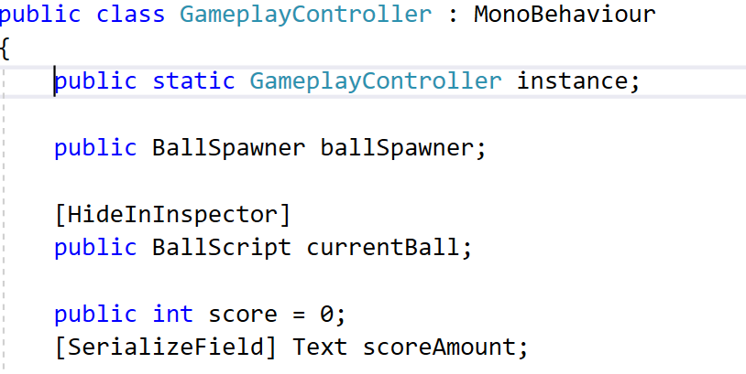
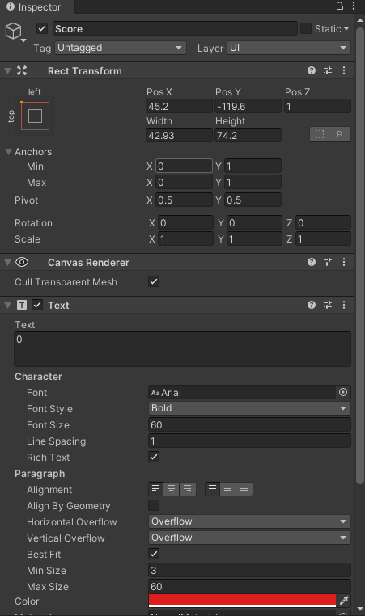
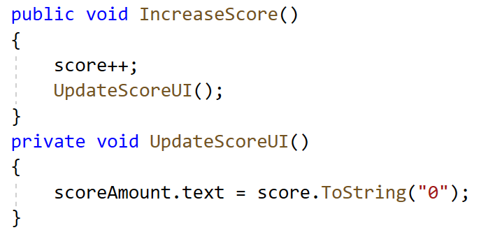
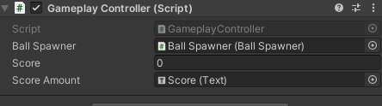
Notes:
As a final touch let’s make a marker for the goals

Slide 36
void DetectInput()
{
#if UNITY_EDITOR
if (Input.GetMouseButtonDown(0))
{
currentBall.Kick();
}
#endif
#if UNITY_IOS
if (Input.touchCount > 0)
{
Touch touch = Input.GetTouch(0);
if (touch.phase == TouchPhase.Ended)
{
currentBall.Kick();
}
}
#endif
#if UNITY_ANDROID
// Handle screen touches.
if (Input.touchCount > 0)
{
Touch touch = Input.GetTouch(0);
if (touch.phase == TouchPhase.Ended)
{
Debug.Log("I'm in an android phone");
currentBall.Kick();
}
}
#endif
}
Notes:
As a final touch let’s make a marker for the goals

Slide 37
Sources
https://www.howtogeek.com/129728/how-to-access-the-developer-options-menu-and-enable-usb-debugging-on-android-4.2/
https://www.youtube.com/watch?v=lvJzVIpqNrc&ab_channel=CocoCode
“Game” – Based on:
https://www.youtube.com/watch?v=4QP0ZTPUaI4&ab_channel=AwesomeTuts
Notes:
Examples of screens
How are touches over time represented?
How can we code for touch interaction?
How can we test mobile features?

